Slide 1
Introduction to Web Development Part 4: Demo Angular – SPA
arnaud.nauwynck@gmail.com
Course Esilv 2023
This document: https://github.com/Arnaud-Nauwynck/presentations/web/angular-demos-4-angular-spa.pdf

Slide 2
Demo Outline
Reminder : http client/server, SPA: Single Page Application
Classical Web app tutorial: « Todo web application »
Rest Api Backend Server – NodeJS,Express,Swagger
Angular + ng-bootstrap setup
Component Pages (offline / mock data) - List Page
- Duplicate/Delete button
- Detail Page
- New Page
- links between pages
Service
HttpClient (call to API backend)
Advanced (ag-grid, …)

Slide 3
SPA = Single Page Application single GET {html|js}, Multiple Rest Json requests
Web Browser
Reminder
/Page1.html
http GET /page1.html
<script>app1.js</script>
http GET /page1.js
app1.js
Parse js
+ execute function init() {.. }
+ parse css + render html
http GET /page1.css
http GET /page1-image2.png
Web Server
CLICK on <button (click)=« callFunction() » >
http POST /api/restEndpoint1 {json}
REPLACE add/remote/update some <div>
Within SAME page
response {json}
http POST /api/restEndpoint2 {json}
response {json}

Slide 4
Reminder FrontEnd / Rest API Backend CORS Origin problem !
Reminder
Because … Web Browser blocks calls to « http://localhost:8080/api/** »
not comming from same « origin domain » as « http://localhost:4000/index.html » «app.js » !
ng serve
Web Browser
static *.html,*.js
:4000
conf/proxy.json (or .js) redirect /api/**
to localhost:8080/api/
Backend server
:8080
Blocked: CORS origin

Slide 5
Reminder : Todo App Web Site Sketch
Reminder
New Form Page
Update Form Page
Update TODO - id : 1234
Description :
Priority:
Description :
Priority:
Home Page
Save
Update
New…
List
List Page
Readonly Detail Page
id : 1
Description : Todo 1
Priority: 2
(id1) Todo 1
Del
Detail
(id2) Todo 2
Del
Detail
List
Edit

Slide 6
Todo Web App Features Description … CRUD
Reminder
C Create
R Read All
Read By Id
U Update
D Delete
Page 1: Simple Html Form with input fields
Click on « Save » button => save « Todo » object on server
Page 2: Show list of « Todos »
page 3 for url « /todo/{id} »
Show detailed « Todo» page
Page 4: Editable page + « update » button
« delete » button

Slide 7
Rest using NodeJs - Express
Reminder
const express = require('express');
const app = express();
app.get('/', function (req, res) {
res.send({ some: 'Hello Json Express' })
});
app.listen(3000);

Slide 8
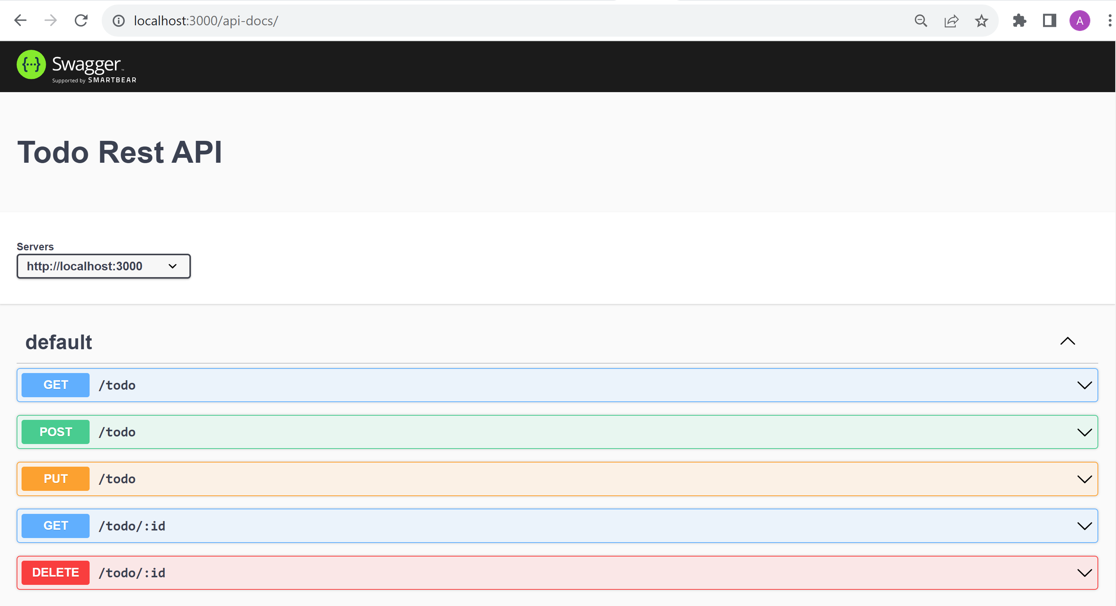
Swagger-UI : http://localhost:3000/api-docs/
Reminder

Slide 9
Demo Outline
Reminder : http client/server, SPA: Single Page Application
Classical Web app tutorial: « Todo web application »
Rest Api Backend Server – NodeJS,Express,Swagger
Angular + ng-bootstrap setup
Component Pages (offline / mock data) - List Page
- Duplicate/Delete button
- Detail Page
- New Page
- links between pages
Service
HttpClient (call to API backend)
Advanced (ag-grid, …)

Slide 10
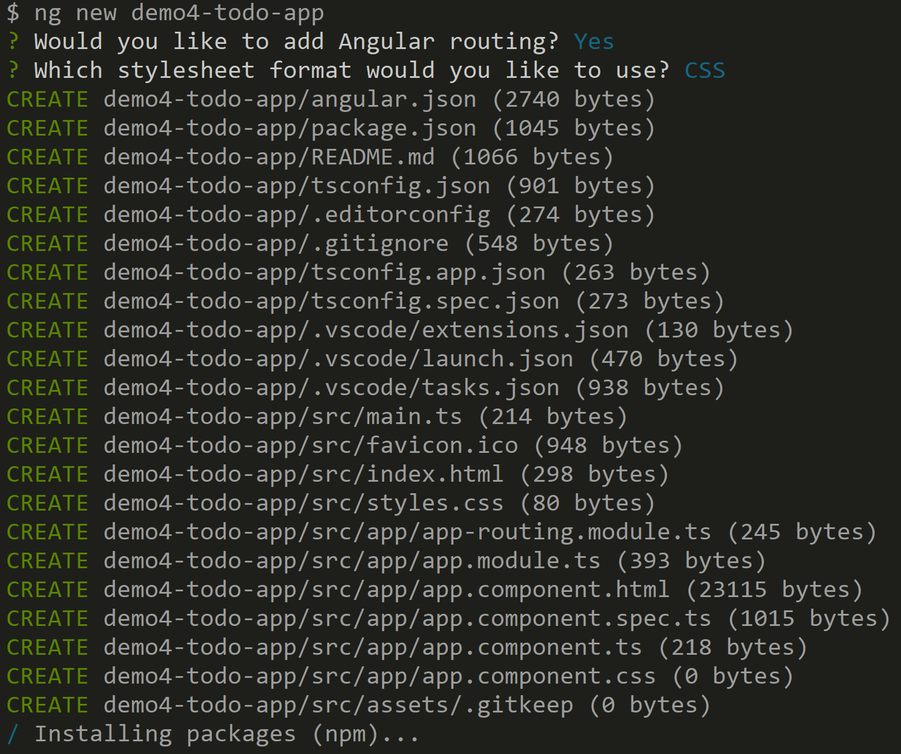
$ ng new

Slide 11
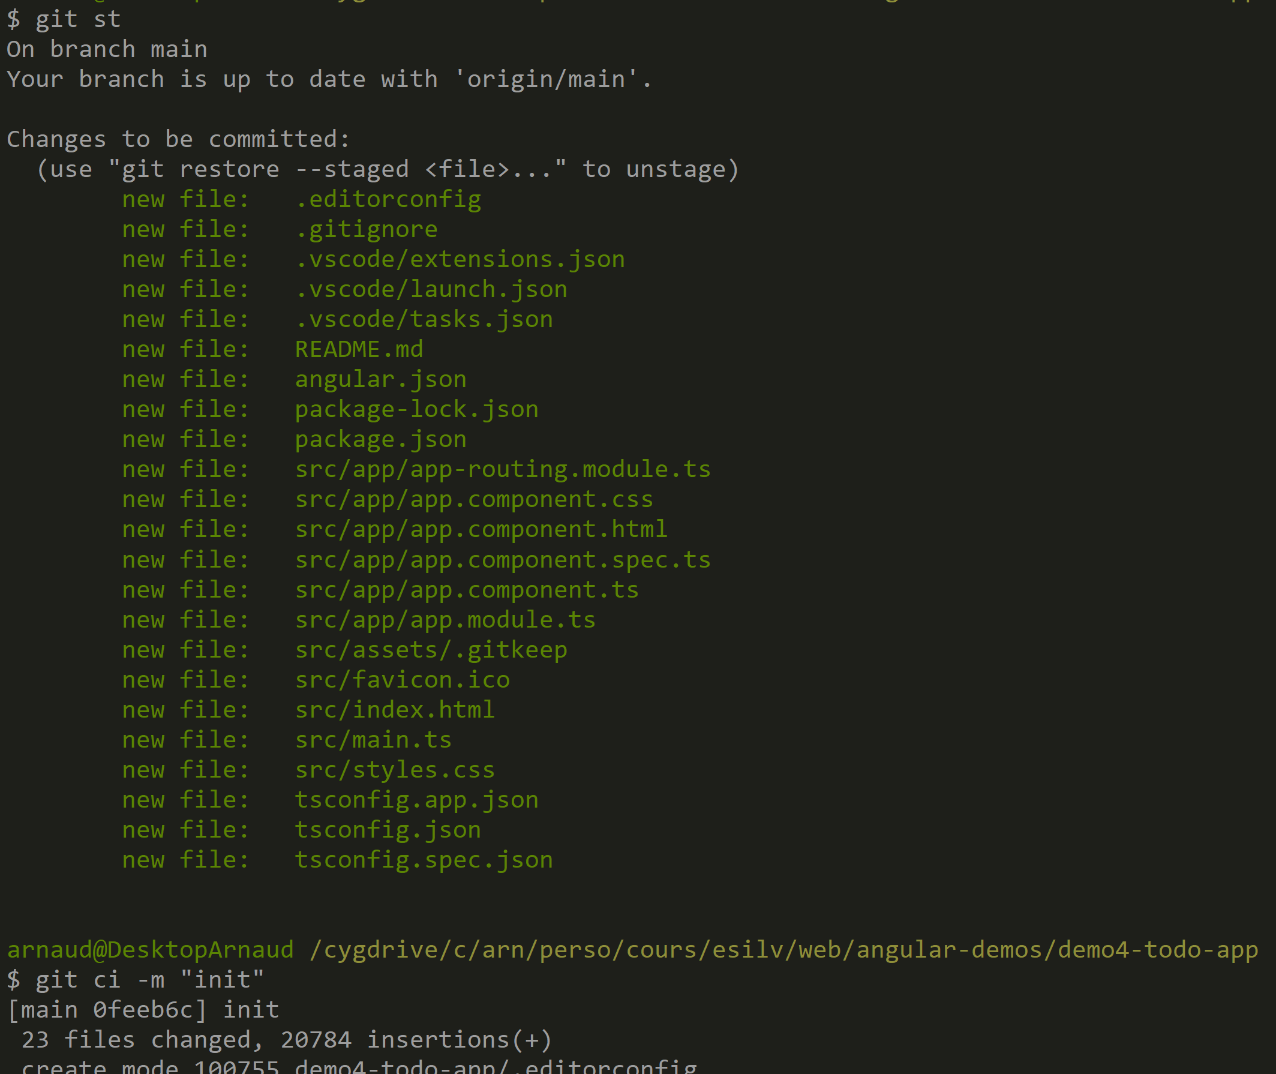
$ git add . ; git ci –m « init »

Slide 12
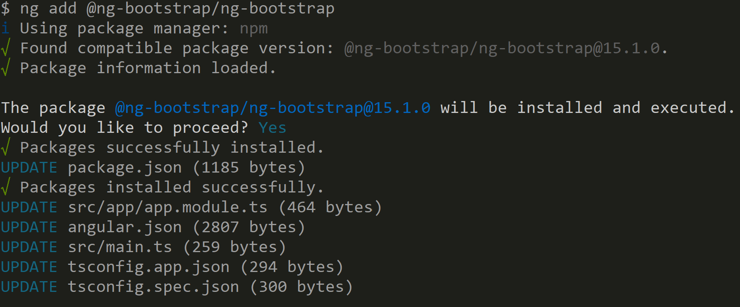
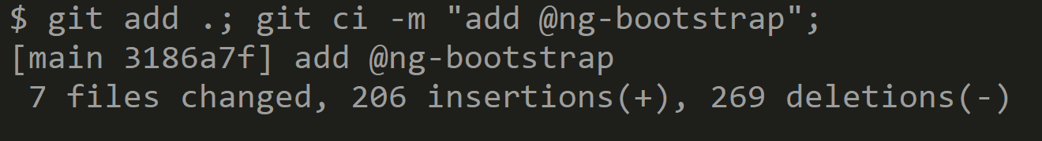
$ ng add @ng-bootstrap/ng-bootstrap

Slide 13
Demo Outline
Reminder : http client/server, SPA: Single Page Application
Classical Web app tutorial: « Todo web application »
Rest Api Backend Server – NodeJS,Express,Swagger
Angular + ng-bootstrap setup
Component Pages (offline / mock data) - List Page
- Duplicate/Delete button
- Detail Page
- New Page
- links between pages
Service
HttpClient (call to API backend)
Advanced (ag-grid, …)

Slide 14
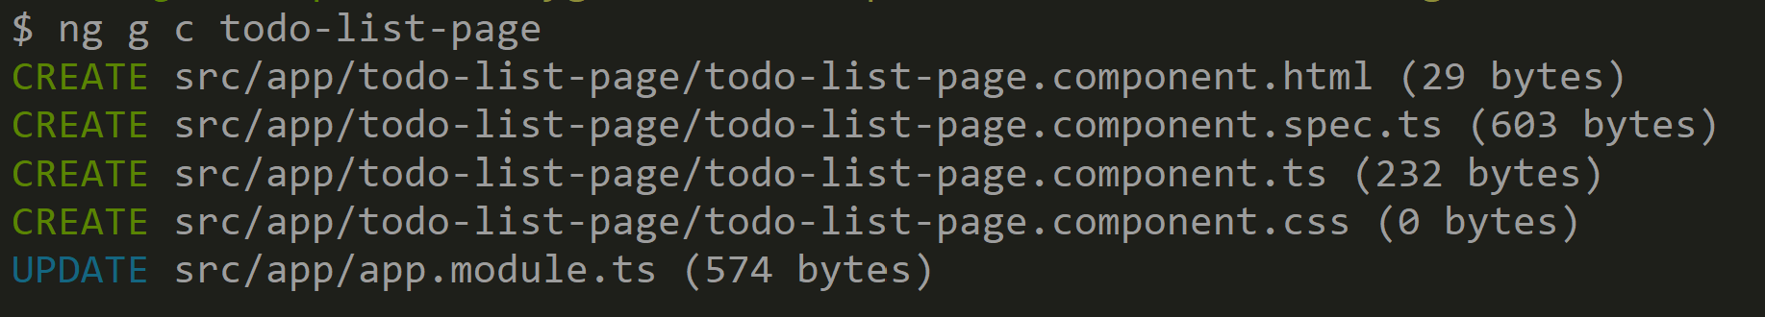
$ ng g c todo-list-page
Basic HTML : <li *ngFor=« let todo of todos »>
Hardcoded Todo objects in *.ts

Slide 15
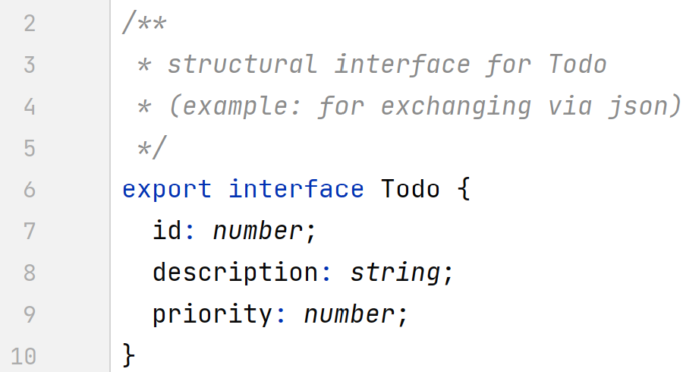
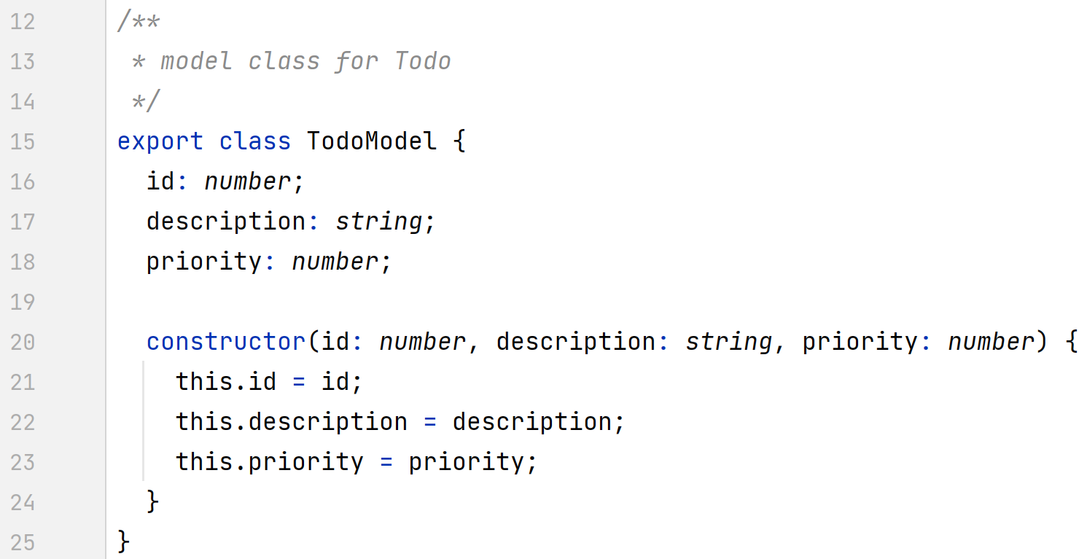
Defining model with Interface or Class

Slide 16
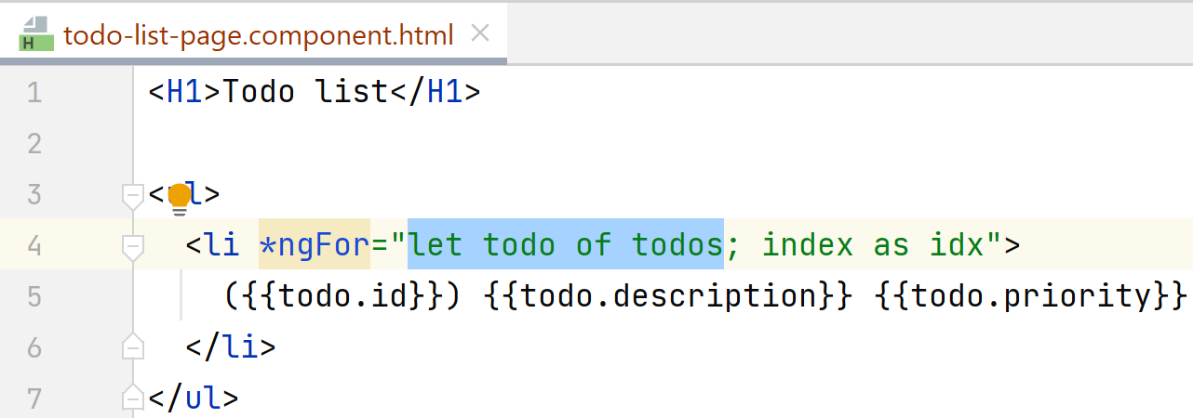
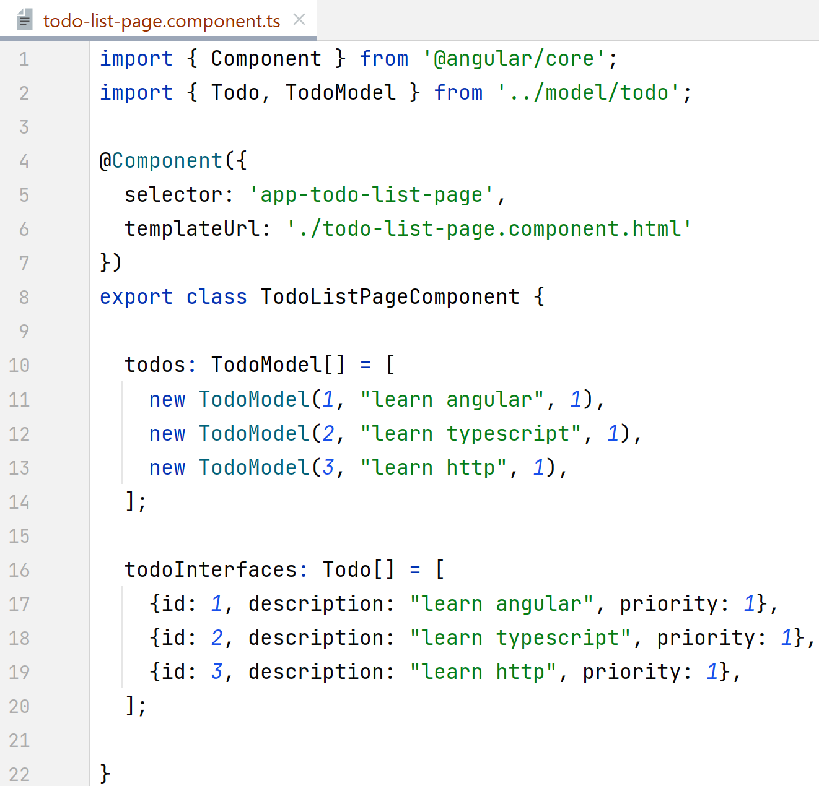
Todo list page
$ ng g c TodoListPage

Slide 17
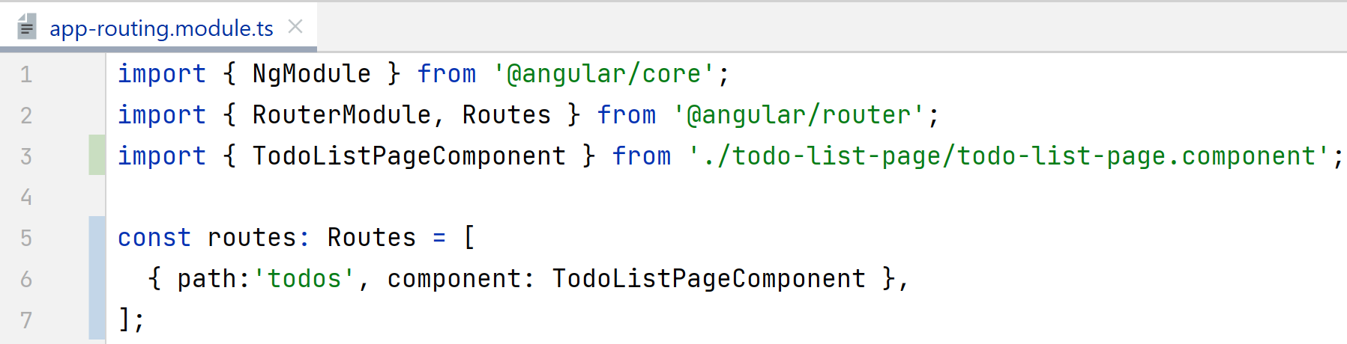
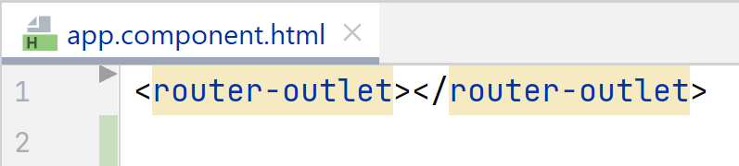
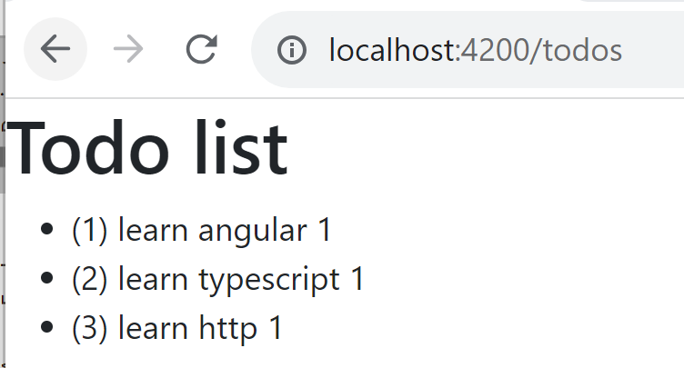
Todo router page « /todos »
Add to router url: « /todos »
Use «router-outlet » in main page

Slide 18
Demo Outline
Reminder : http client/server, SPA: Single Page Application
Classical Web app tutorial: « Todo web application »
Rest Api Backend Server – NodeJS,Express,Swagger
Angular + ng-bootstrap setup
Component Pages (offline / mock data) - List Page
- Duplicate/Delete button
- Detail Page
- New Page
- links between pages
Service
HttpClient (call to API backend)
Advanced (ag-grid, …)

Slide 19
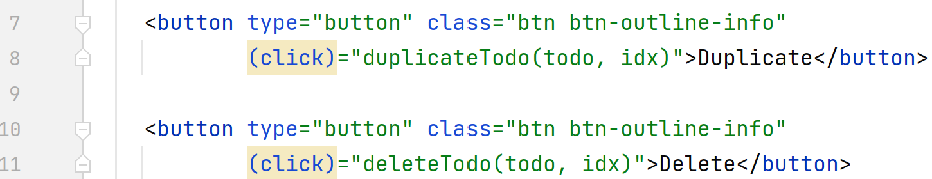
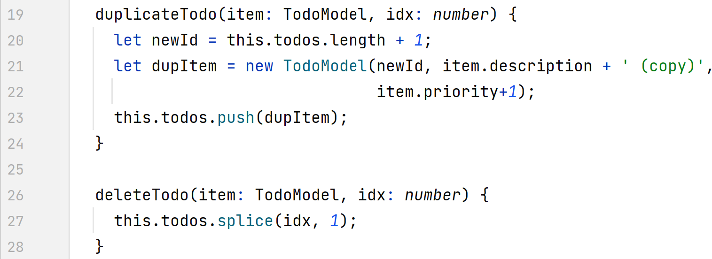
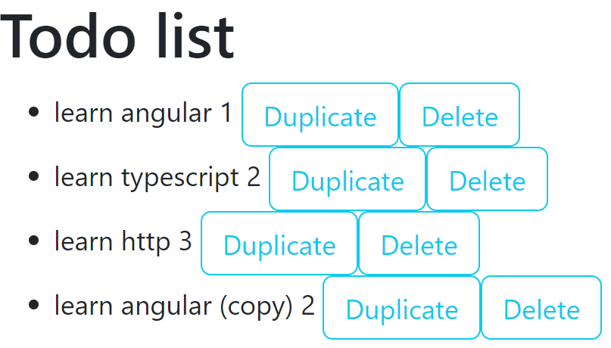
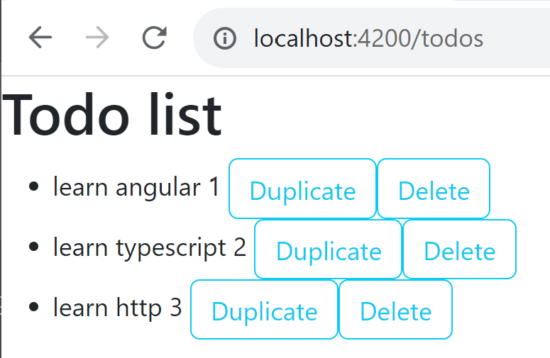
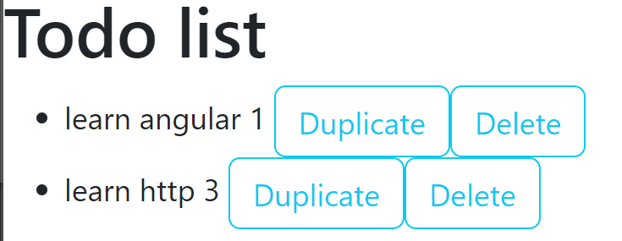
Button to duplicate / delete Todo

Slide 20
Demo Outline
Reminder : http client/server, SPA: Single Page Application
Classical Web app tutorial: « Todo web application »
Rest Api Backend Server – NodeJS,Express,Swagger
Angular + ng-bootstrap setup
Component Pages (offline / mock data) - List Page
- Duplicate/Delete button
- Detail Page
- New Page
- links between pages
Service
HttpClient (call to API backend)
Advanced (ag-grid, …)

Slide 21
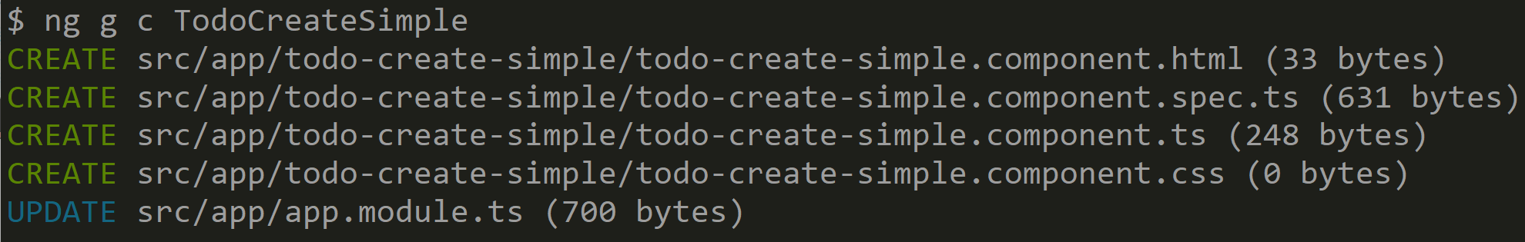
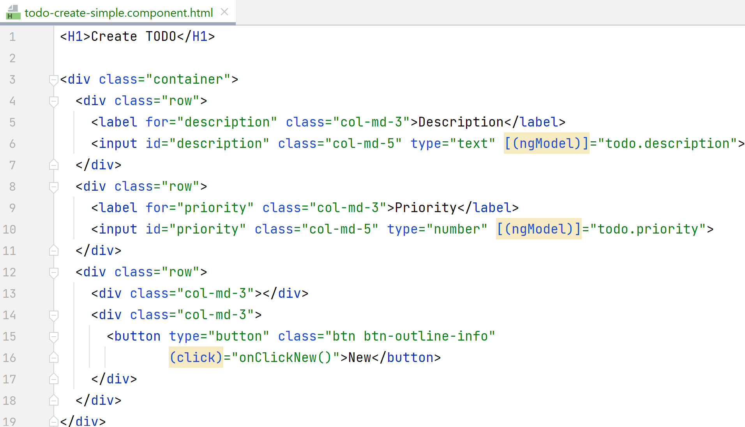
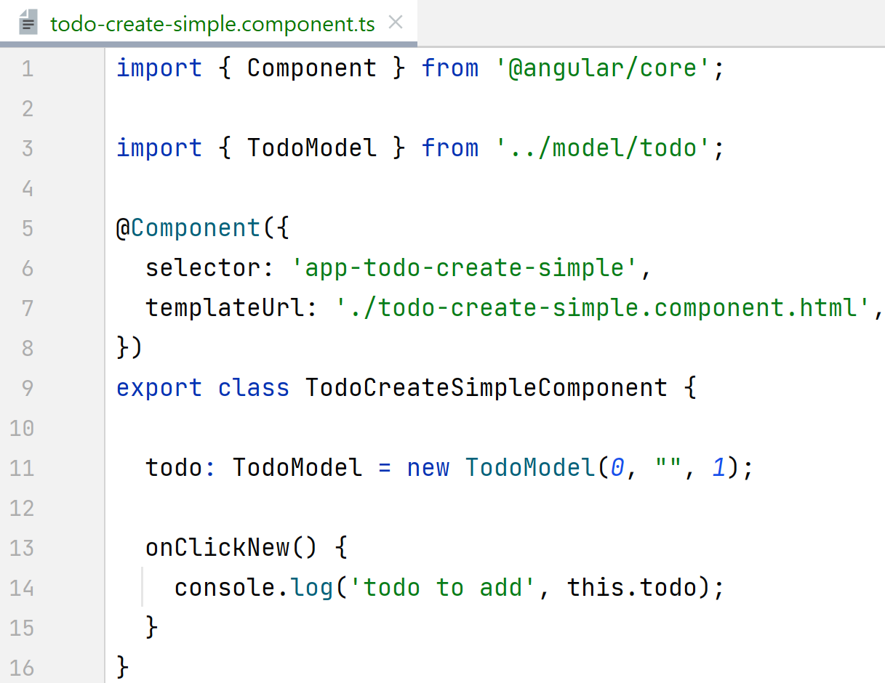
New Todo basic « Form »

Slide 22
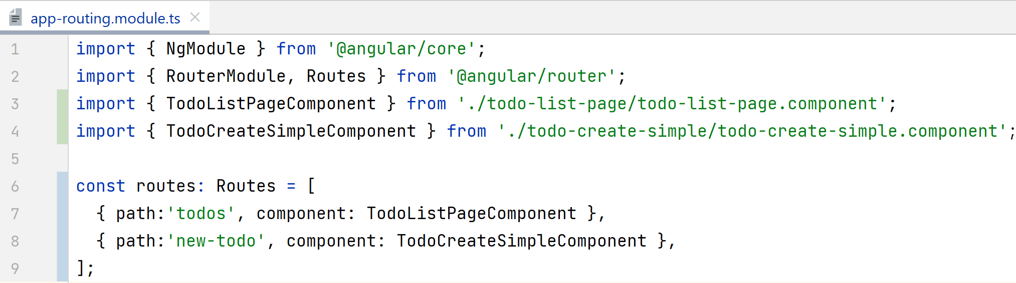
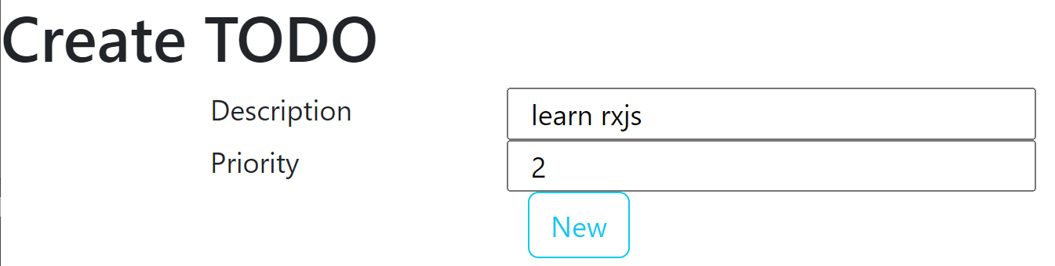
Add router « new-todo »

Slide 23
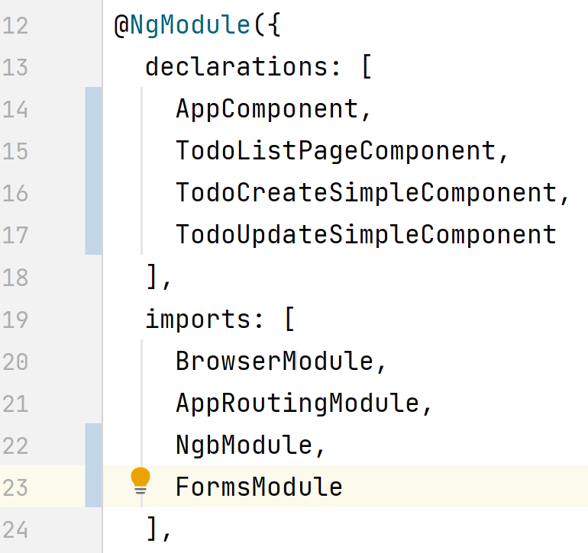
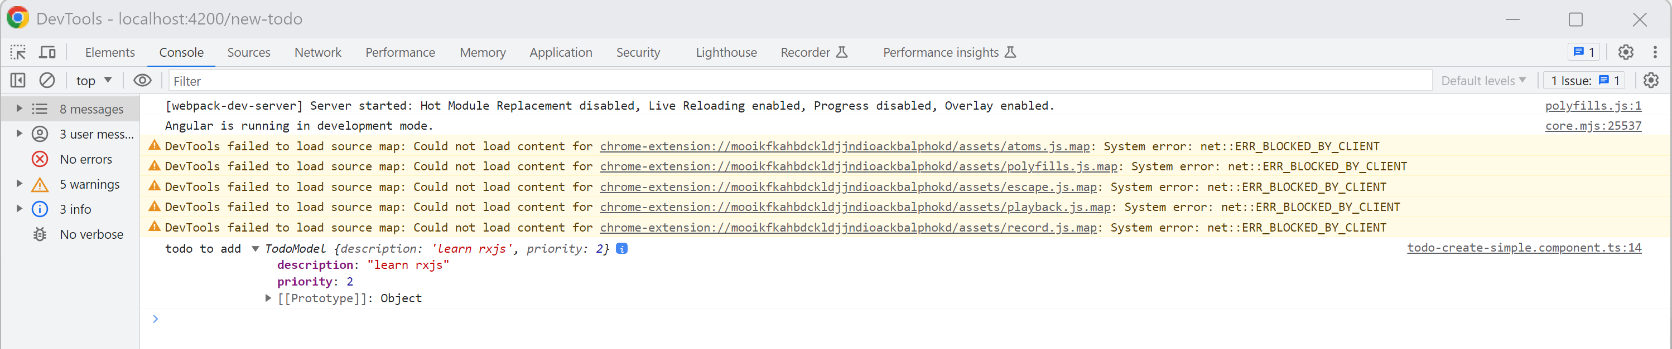
Basic Form … [(ngModel)]=.. Need FormsModule no validation yet
Click + F12 Debugger Console

Slide 24
Demo Outline
Reminder : http client/server, SPA: Single Page Application
Classical Web app tutorial: « Todo web application »
Rest Api Backend Server – NodeJS,Express,Swagger
Angular + ng-bootstrap setup
Component Pages (offline / mock data) - List Page
- Duplicate/Delete button
- Detail Page
- New Page
- links between pages
Service
HttpClient (call to API backend)
Advanced (ag-grid, …)

Slide 25
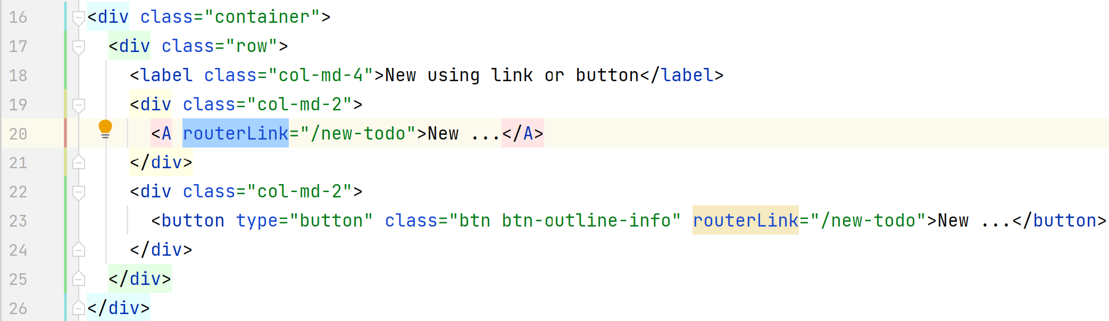
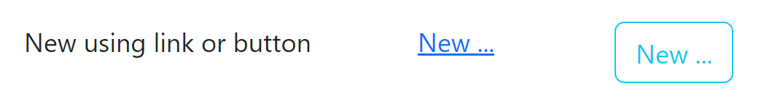
add <A> or <button> « routerLink »
url: /todos
To url: /new-todo

Slide 26
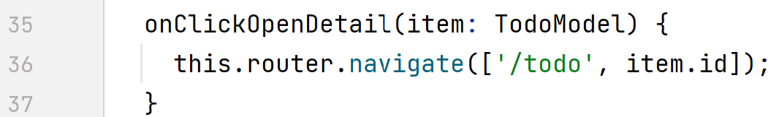
Add Button with contextual id « /todo/id » router.navigate([« /todo », id]);

Slide 27
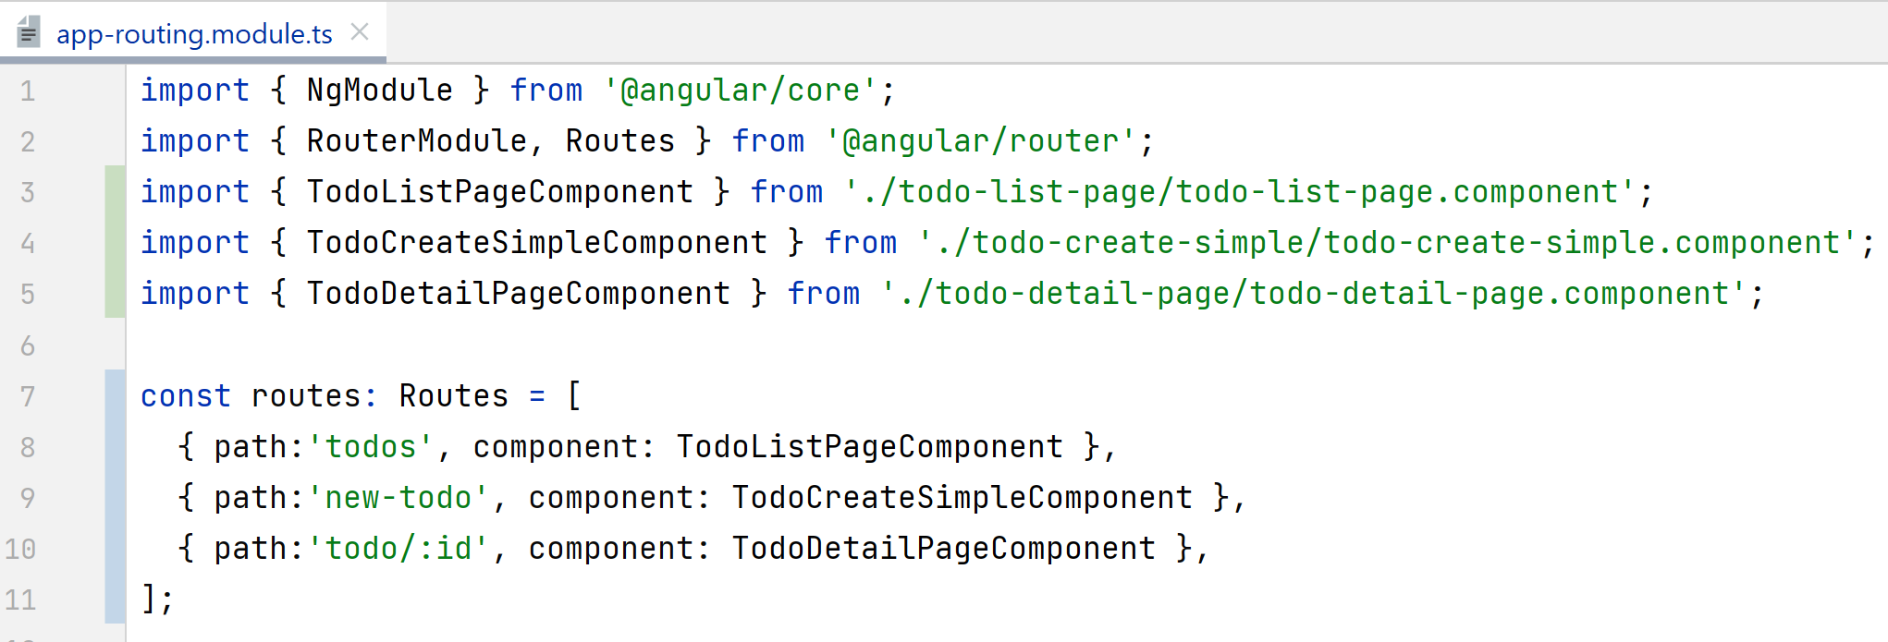
Declare url « /todo/:id » with path parameter

Slide 28
Demo Outline
Reminder : http client/server, SPA: Single Page Application
Classical Web app tutorial: « Todo web application »
Rest Api Backend Server – NodeJS,Express,Swagger
Angular + ng-bootstrap setup
Component Pages (offline / mock data) - List Page
- Duplicate/Delete button
- Detail Page
- New Page
- links between pages
Service
HttpClient (call to API backend)
Advanced (ag-grid, …)

Slide 29
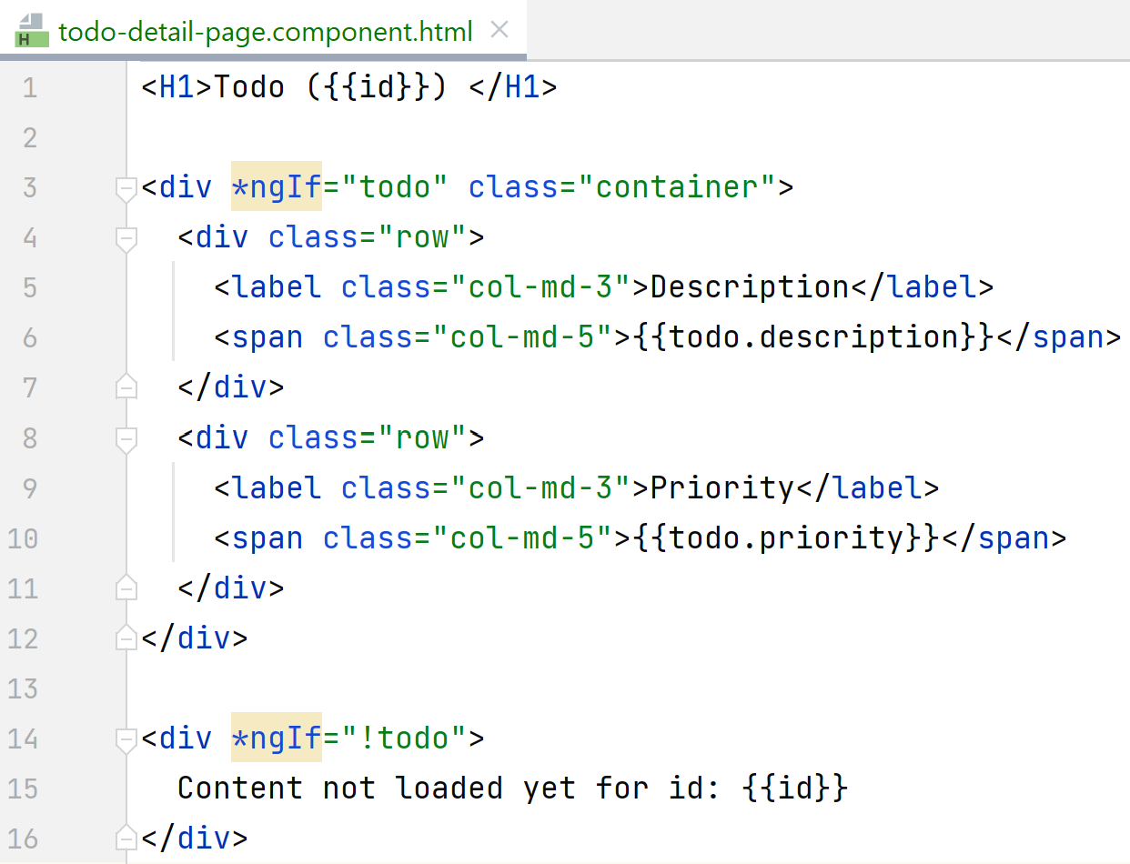
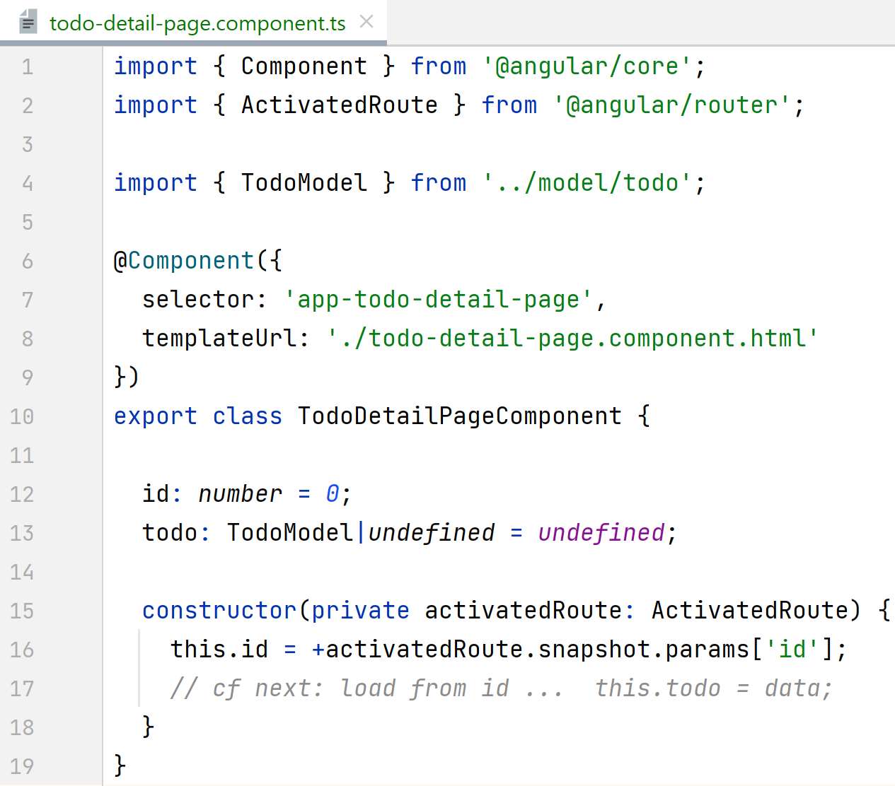
Todo Detail page for « /todo/:id »

Slide 30
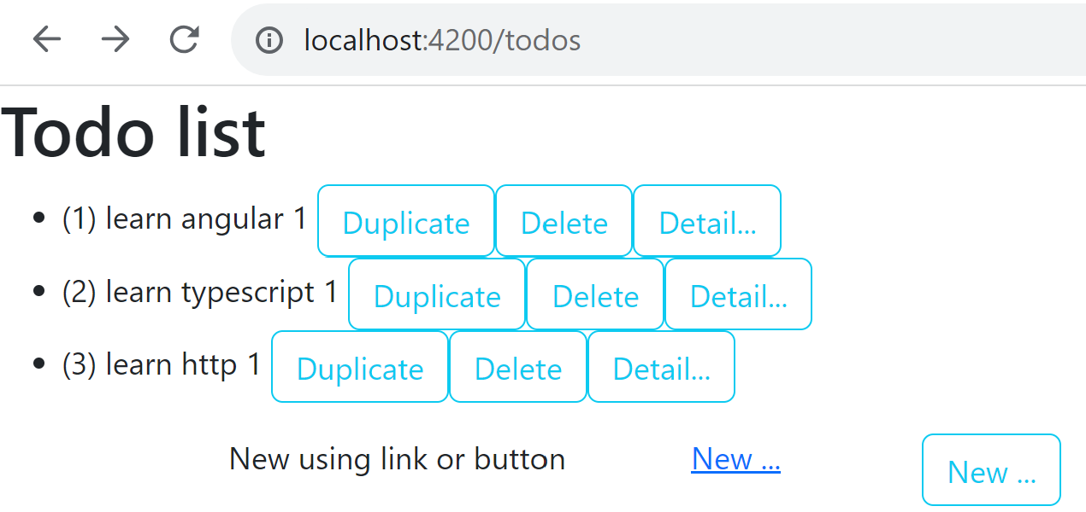
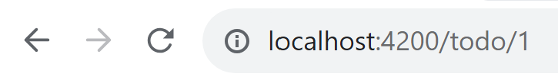
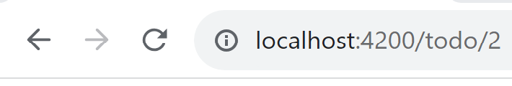
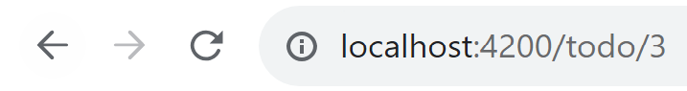
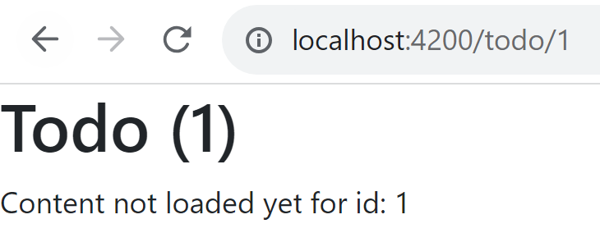
Todo Detail Page

Slide 31
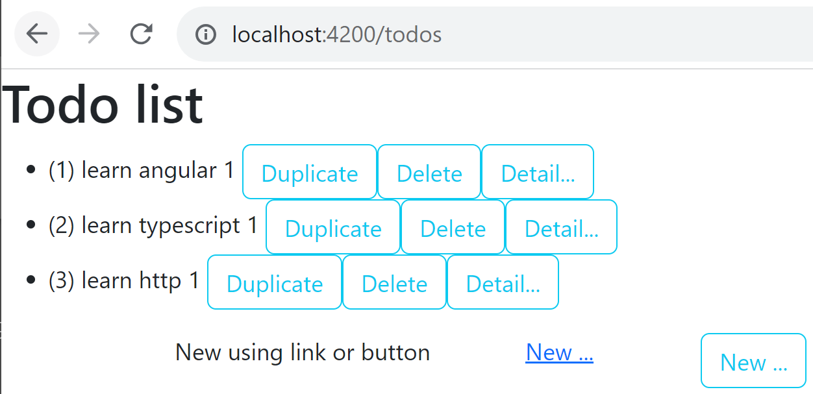
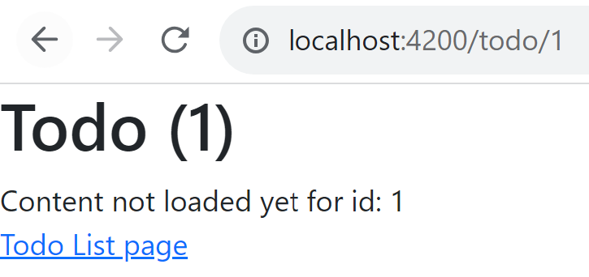
Back to Todo List button

Slide 32
Demo Outline
Reminder : http client/server, SPA: Single Page Application
Classical Web app tutorial: « Todo web application »
Rest Api Backend Server – NodeJS,Express,Swagger
Angular + ng-bootstrap setup
Component Pages (offline / mock data) - List Page
- Duplicate/Delete button
- Detail Page
- New Page
- links between pages
Service
HttpClient (call to API backend)
Advanced (ag-grid, …)

Slide 33
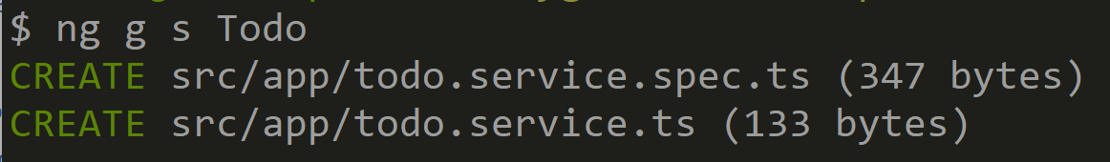
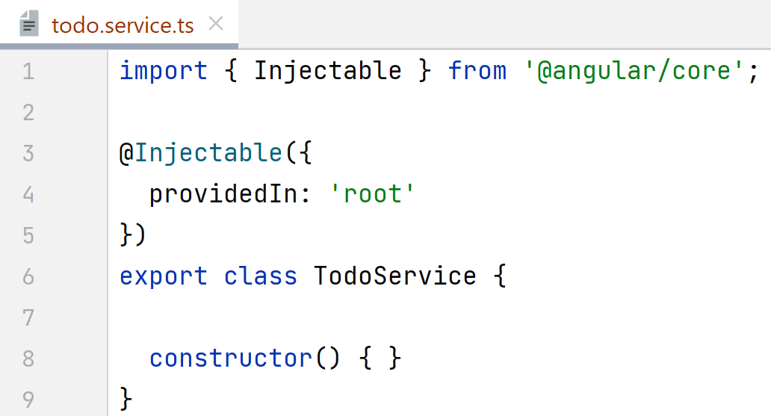
Storing model in Service class (lifecycle != Component)

Slide 34
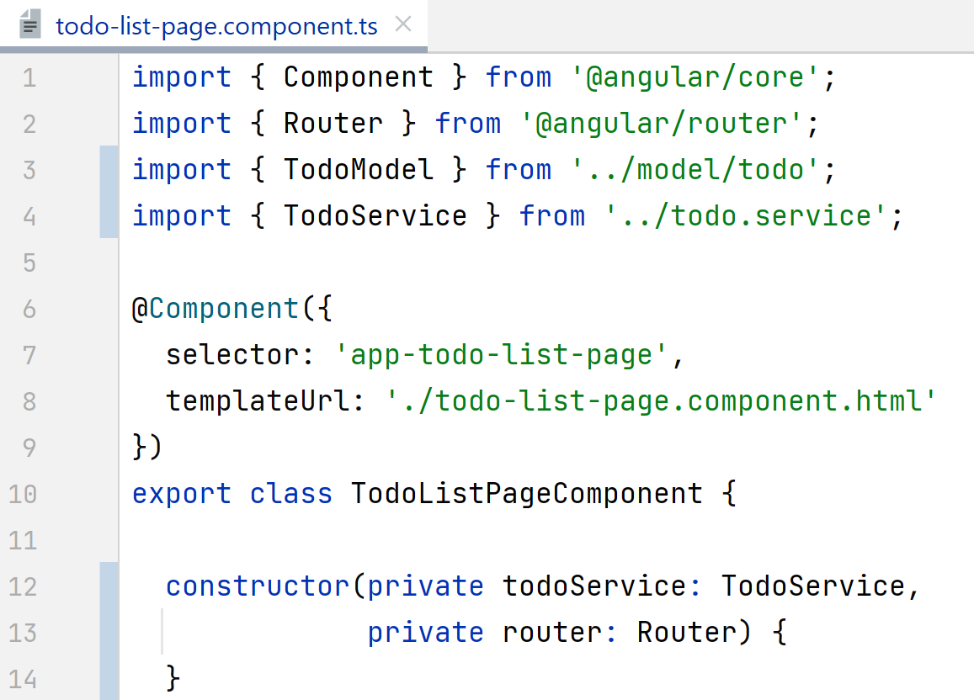
inject Service in Component constructor

Slide 35
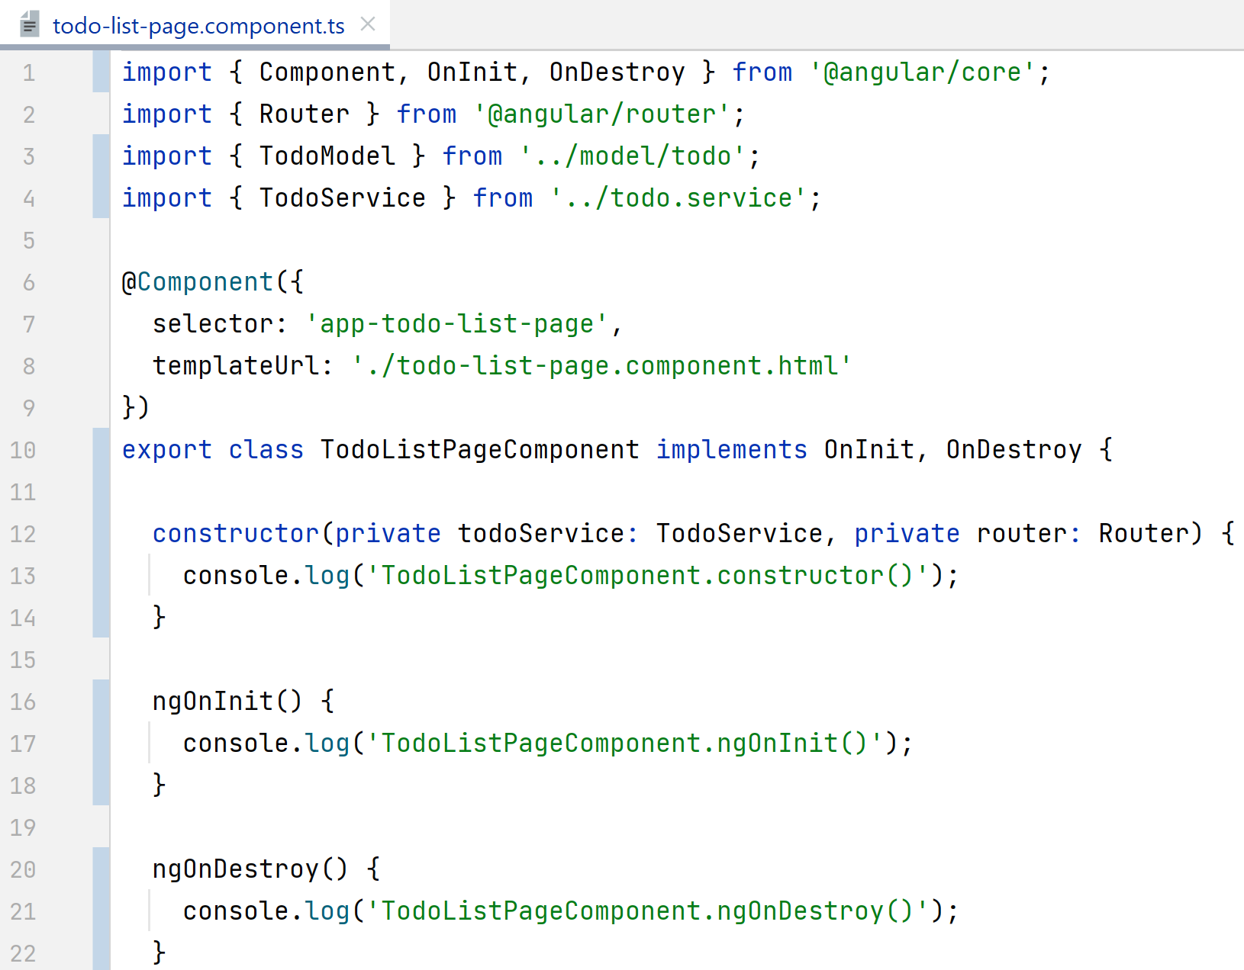
Showing LifeCycle: console.log() in constructor(), ngOnInit(), ngOnDestroy()

Slide 36
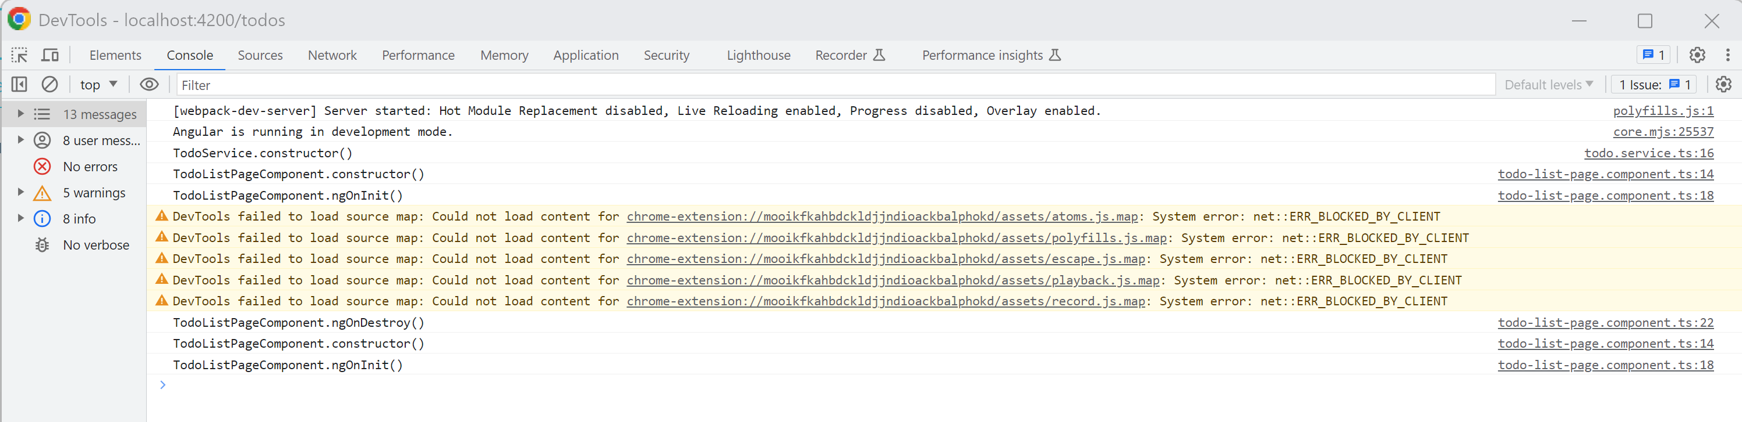
Showing Life Cycle

Slide 37
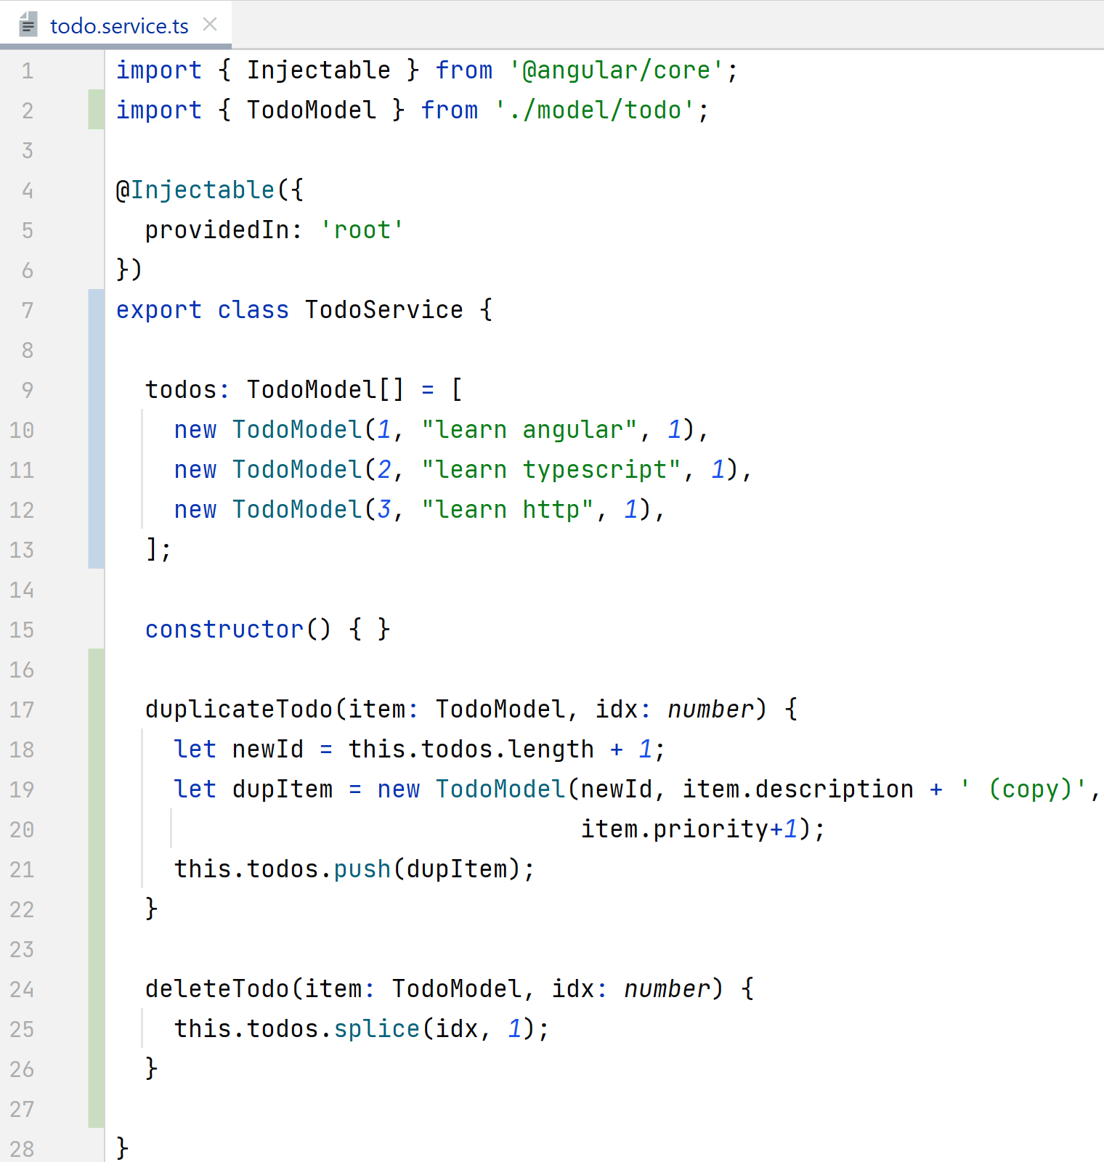
Refactor: move « todos » code in service

Slide 38
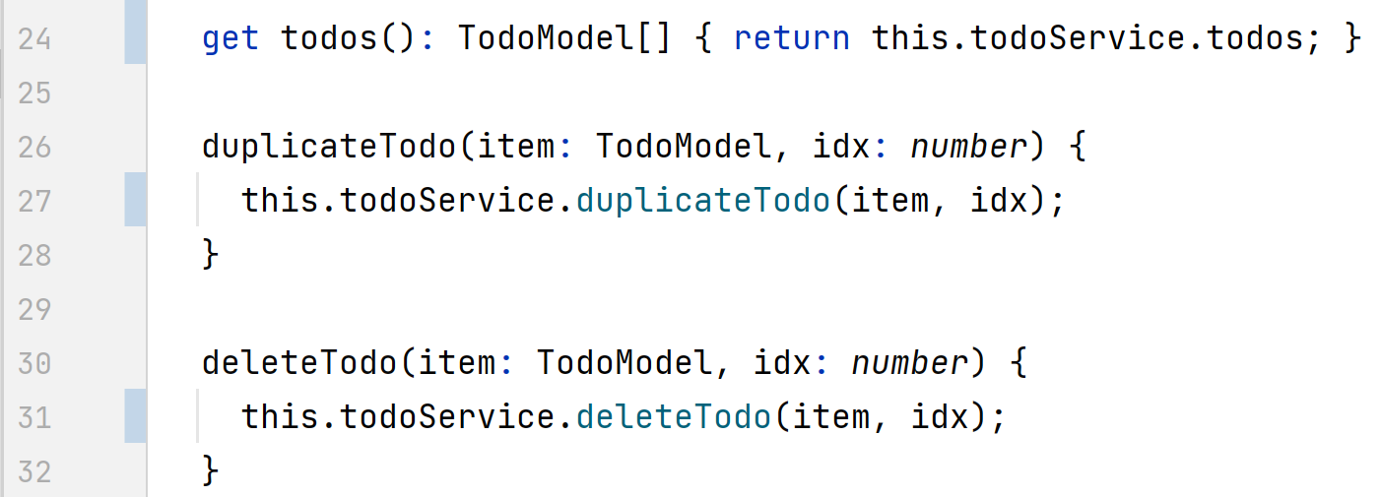
Refactor Component: call service methods

Slide 39
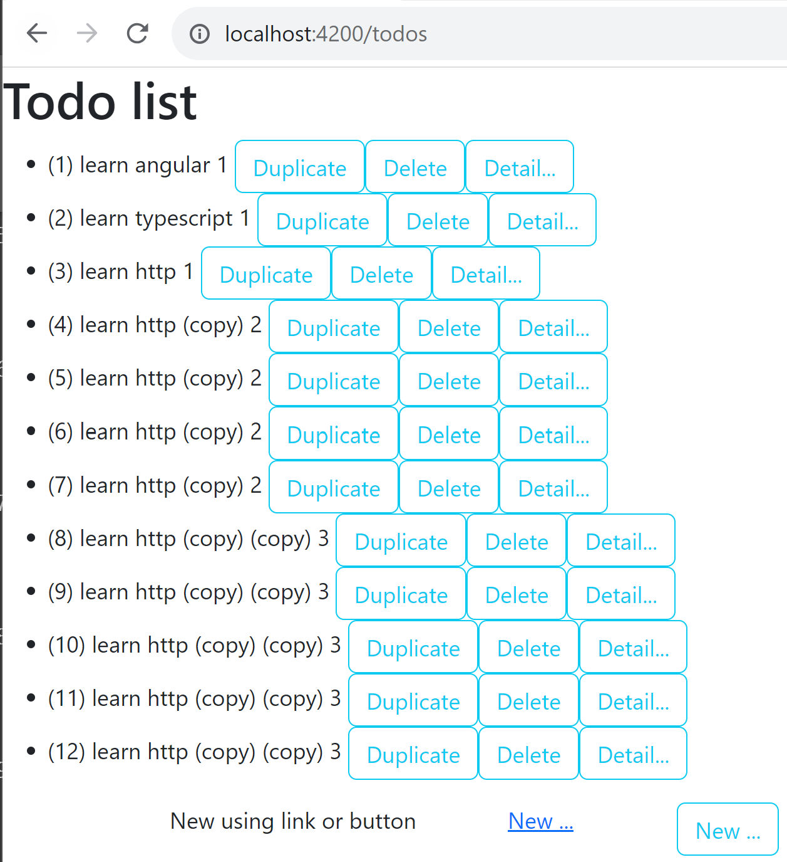
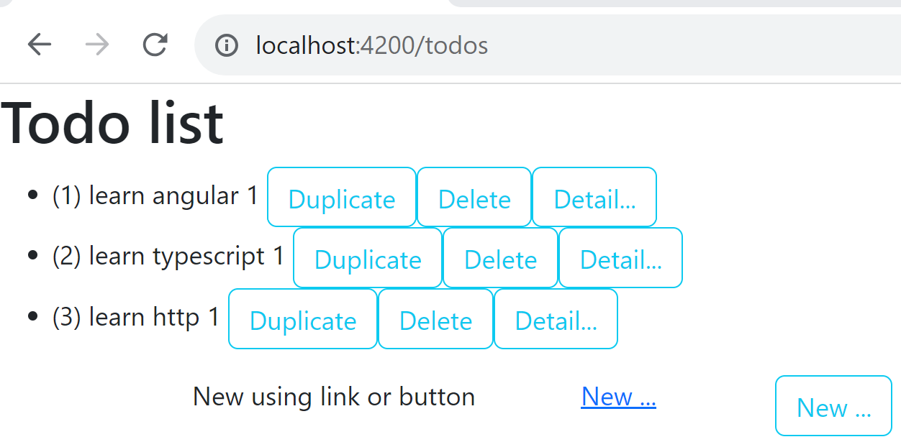
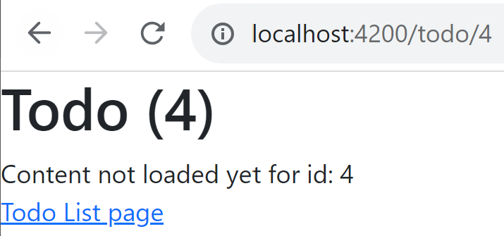
Navigate pages => Todos in-memory stored Refresh page => Todos reset
In-memory change
F5 (reload page)

Slide 40
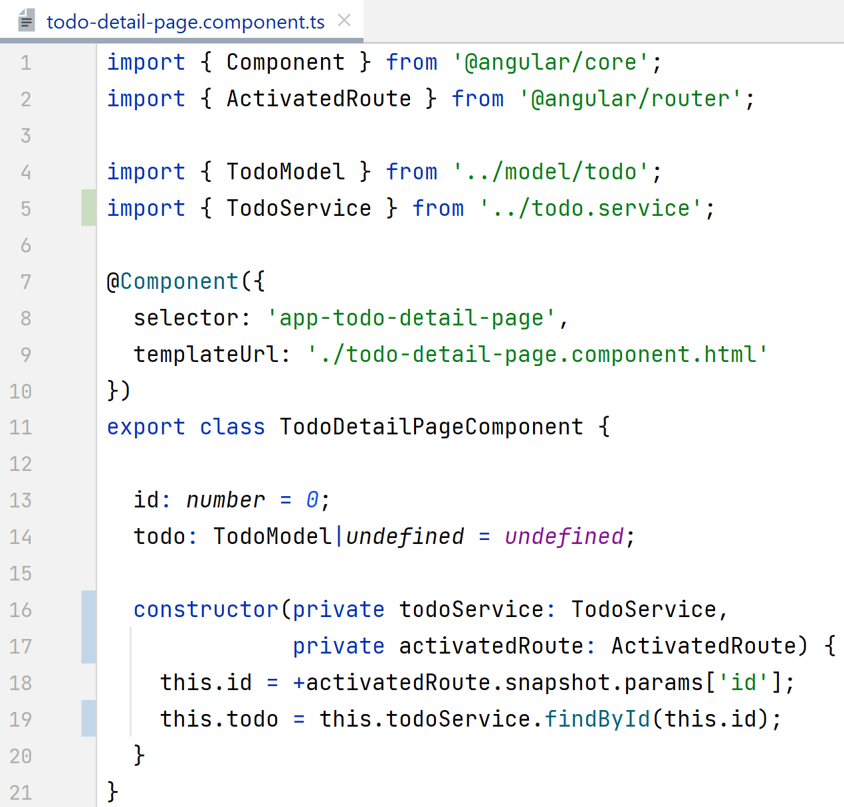
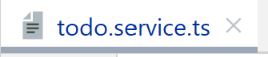



Using Service for detailed page « /todo/:id » « todoService.findById(id) »

Slide 41



Using Service for « new » Form page

Slide 42
Demo Outline
Reminder : http client/server, SPA: Single Page Application
Classical Web app tutorial: « Todo web application »
Rest Api Backend Server – NodeJS,Express,Swagger
Angular + ng-bootstrap setup
Component Pages (offline / mock data) - List Page
- Duplicate/Delete button
- Detail Page
- New Page
- links between pages
Service
HttpClient (call to API backend)
Advanced (ag-grid, …)

Slide 43


Using HttpClient Module

Slide 44


Calling http from Service

Slide 45

Configuring angular proxy.json

Slide 46

proxy.json

Slide 47

Test http GET http://localhost:4200/api/todo => http GET http://localhost:3000/todo

Slide 48
Take Away

Slide 49
Questions

Slide 50
Next Steps …

